Slide 1

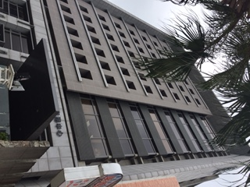

博 克 聯 合 有 限 公 司 PULTEK ASSOCIATION CO.,LTD
Established : 1998/ 9 月
Capital : USD 300,000.
Head Office : Hsin chu , Taiwan ,R.O.C
Revenue： NTD 6000 萬
Affiliated company：
盛郁實業有限公司
Primary-Tech-Enterprise Co.,LTD
勝益氣體股份有限公司
Shen Yi Gas Co.,LTD
Main Business :
Instrumentation Fittings & Valves
GAS MFM & MFC
BA/EP SUS 316L Tube
Tube Welding Fitting

Slide 2






博 克 聯 合 有 限 公 司 PULTEK ASSOCIATION CO.,LTD
 | Fitting Industry Valve UCV Valve |  | UCV Valve Bellow Valve
 | Replace Brand ：Swagelok |  | Replace Brand ：Fujikin
 | conversion ratio：90% |  | conversion ratio：70%
 | Digital MFM & MFC Analog MFM & MFC Heavy Idustry Thermal MFM Mass Vortex Flow Meter |  | UHP Regulator UHP Valve Vaccum Generator Module Flow Switch
 | Replace Brand ：MKS , Horiba , Fufikin |  | Replace Brand ：Parker
 | conversion ratio：80% |  | conversion ratio：90%
 | Metal Gas Filter Metal Gasket Filter Flow Restrictors Metal Difuuser |  | Pressure Gauge Pressure Transmitter
 | Replace Brand ：PALL , TEM |  | Replace Brand : Nagano
 | conversion ratio：60% |  | conversion ratio：90%

Slide 3
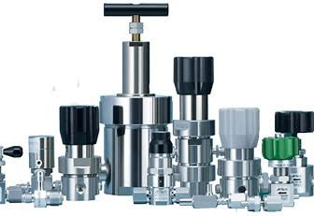
Regulator Introduction
Definition of regulator parts
Regulator Function
Regulator types
Regulator Leak

Slide 4
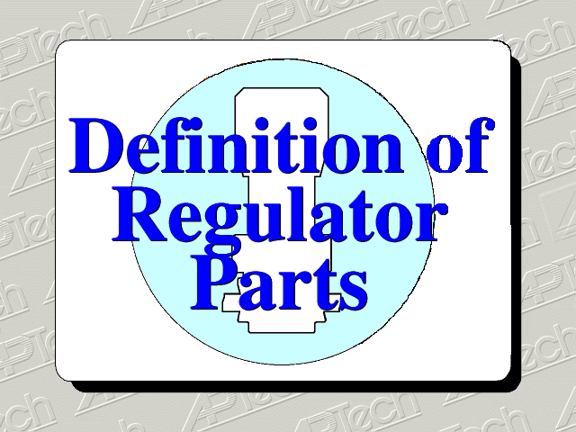
Regulator Parts

Slide 5
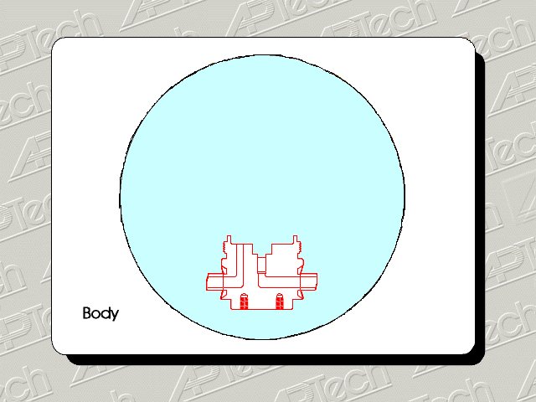
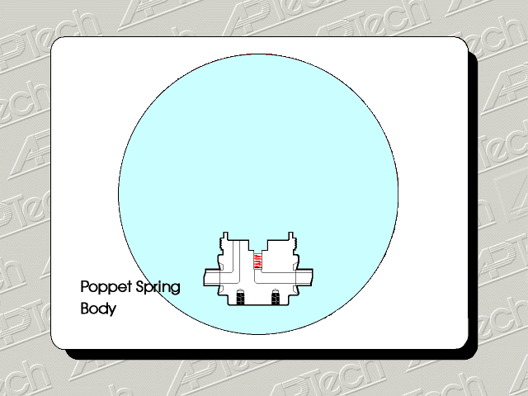
Regulator Parts
Body
--Materials
316 L double melt
316 L single melt
Hastelloy
Poppet Spring
--Materials
316 SST single melt
Hastelloy

Slide 6
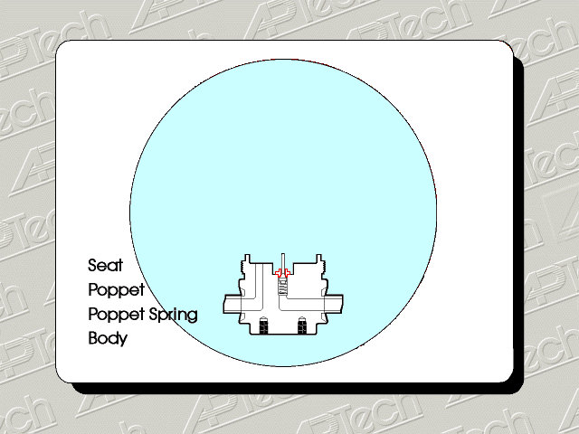

Regulator Parts
Poppet
--Meters gas across seat
--Moves vertically down
away from seat
Seat
--Forms the orifice in the
regulator
--Materials
PCTFE
Vespel
Peek

Slide 7
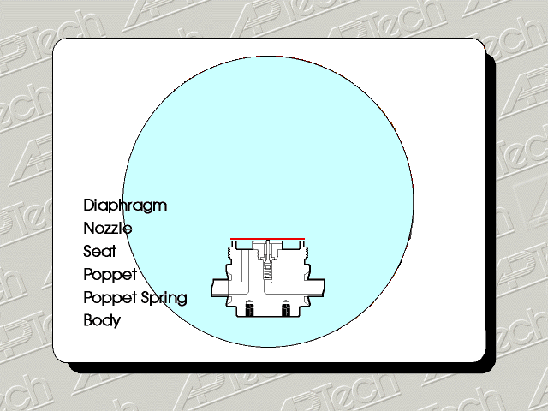
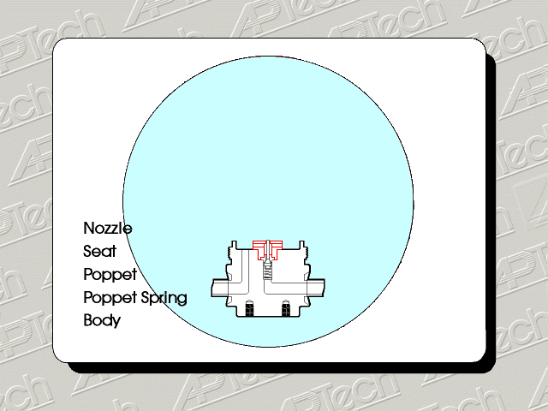
Regulator Parts
Nozzle
--Clamps seat in the body
Diaphragm
-- Materials
Ni-Cr-Mo alloy
--Normally incorporates
convolutions to provide
better diaphragm movement

Slide 8
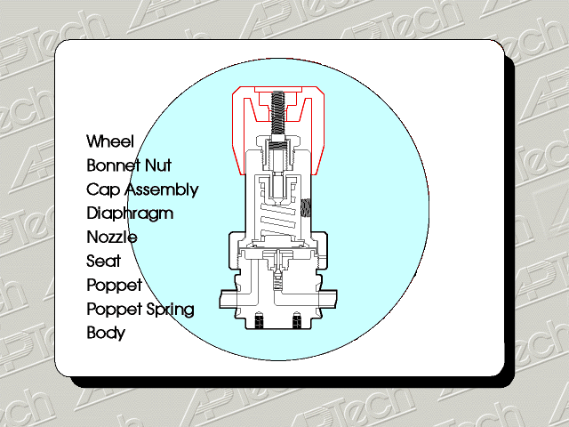
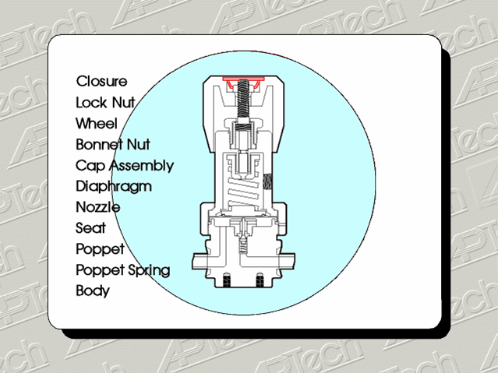
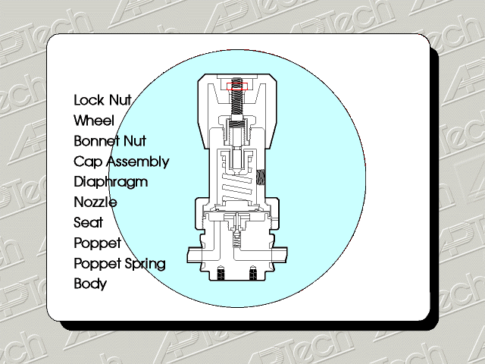
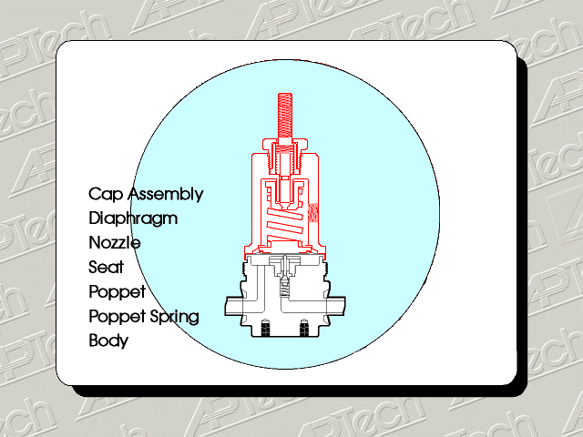
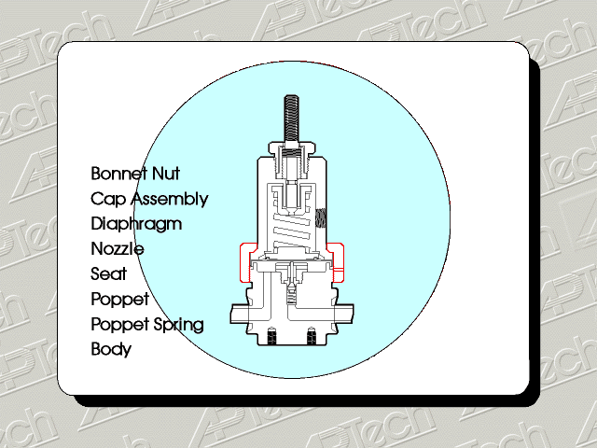
Regulator Parts
Cap Assembly
--adjusting stem and spring
on diaphragm to set outlet
pressure
Bonnet Nut
--Holds cap assemble and
diaphragm against body of
regulator

Slide 9
(How It Works)
Regulator Function
Regulators are used to reduce an inlet pressure to a lower outlet pressure
If on/off shut off is desired, use a valve not a regulator

Slide 10
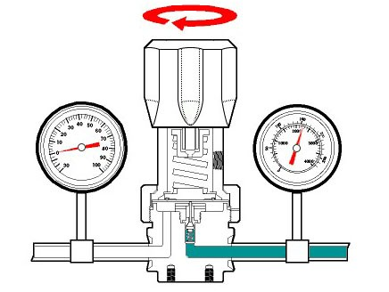
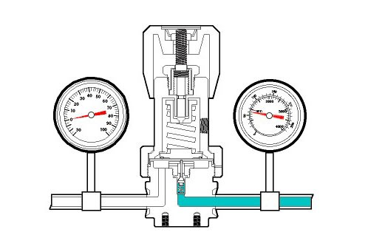
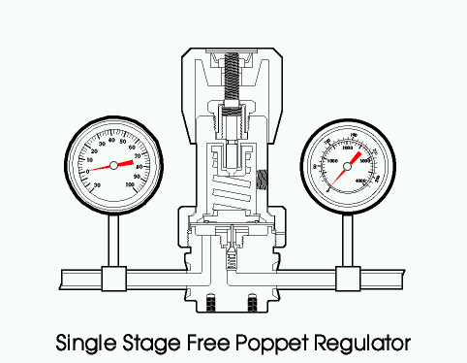
Regulator Function
No gas introduced, so no pressure
Knob turned off
--Poppet closed against seat
--Gas contained to inlet side
Turning knob
--compresses spring creating downward force on diaphragm
--Poppet pushed away from seat allowing gas to flow from inlet side to outlet side

Slide 11
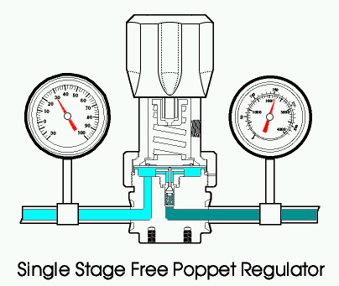
Outlet Pressure Setting Achieved
Regulator Function
Knob Spring downward force on diaphragm
Gas pressure creates upward force on diaphragm
Set point achieved when forces are equal
At set point, with no flow, poppet is against the seat

Slide 12
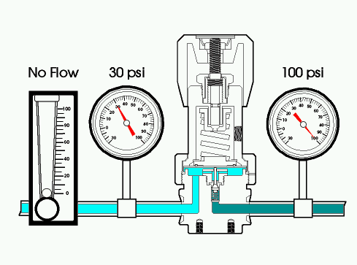
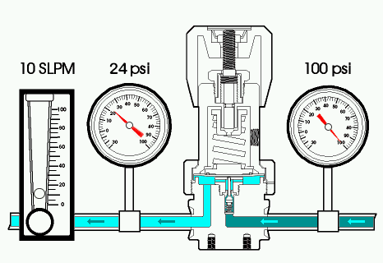
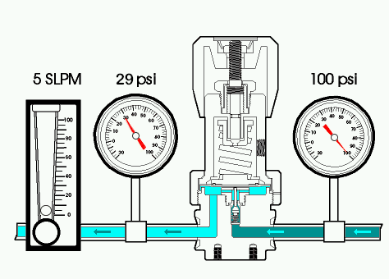
Pressure Drop with Flow
Regulator Function
Static Condition
*Flow: 0 SLPM
*5 SLPM Flow Rate
-- Outlet pressure decreases
from 30 psig to 29 psig
*10 SLPM Flow Rate
-- Outlet pressure falls
from 29 to 24 psig

Slide 13
Droop Causes and Effects
Regulator Function
--Force required to move
diaphragm and poppet
away from seat
Adjustment spring extension
Supply pressure & pressure fouce area
-- Supply pressure
--Orifice (annular area
between seat and poppet)
and diaphragm effective
area and stroke (travel)
Force balance equation:
Adjustment Spring=Supply pressure+pressure fouce area

Slide 14
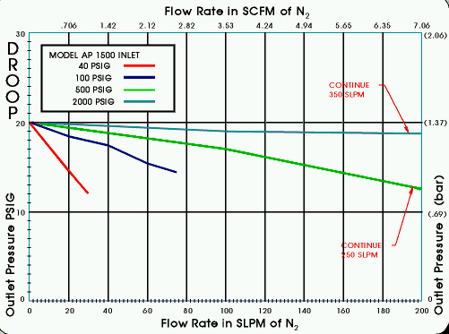
Droop Chart/Curve
Regulator Function
AP1500 flow curves with four different inlet pressures
Vertical axis for pressure and horizontal axis flow
As inlet pressure decreases, droop increases

Slide 15
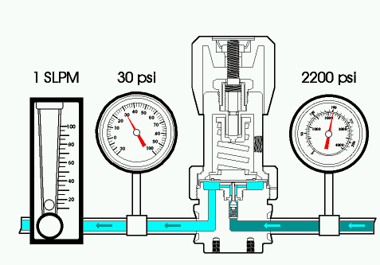
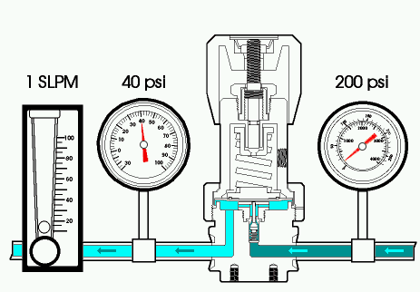
Supply Pressure Effect
Regulator Function
Regulator shown attached to full gas cylinder at 2200 psig
Gas cylinder is consumed to 200 psig
Note outlet pressure rise to 40 psig Flow
Flow rate still constant at 1 SLPM

Slide 16
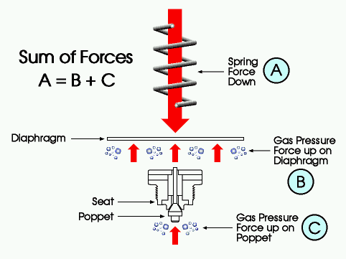
Supply Pressure Effect - Cause
Regulator Function
Force balance equation
--A = B + C
Gas cylinder from 2200 to 200 psig
-- “C” decreases
Force “B” increases
--maintain the force balance
**Supply pressure effect
determined by ratio of
diaphragm area to
orifice area

Slide 17
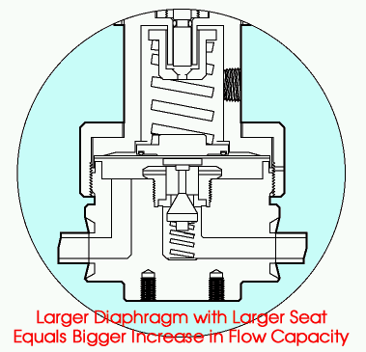
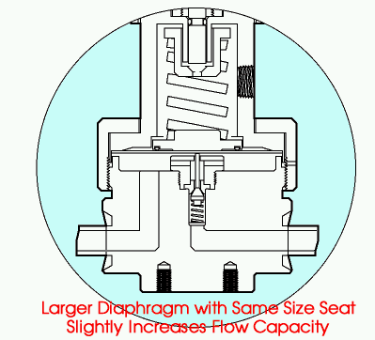
Examples
Regulator Function
low flow regulator
--0.5 psi rise per 100 psi drop in source pressure
--10 psi rise in outlet for a 2,000 psi drop in source pressure
high flow regulator
--4 psi rise per 100 psi drop in source pressure
-- 80 psi rise in outlet for a 2,000 psi drop in source pressure

Slide 18
Regulator Types
Free Poppet Regulators
Tied Diaphragm Regulators
Two Stage Regulators
Absolute Pressure Regulators
Springless Regulator

Slide 19
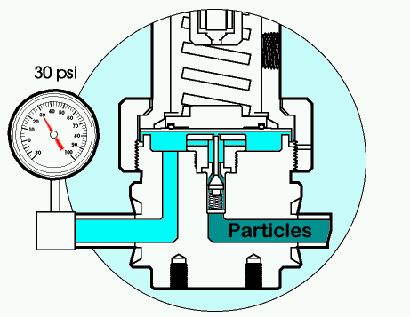
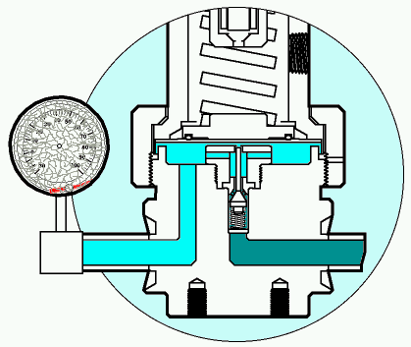
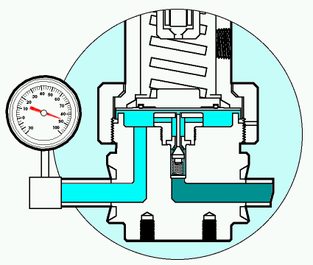
Free Poppet Regulator
Regulator Types
Not have a mechanical link between the diaphragm and poppet
If particle are in the gas they can get lodged between the seat and the poppet
gas leaks across the seat causing an increase of outlet pressure
Pressure rises to over 80 psig

Slide 20
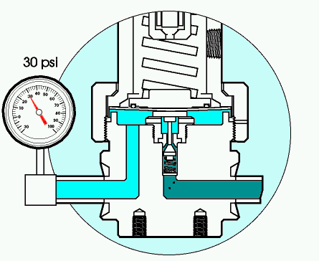
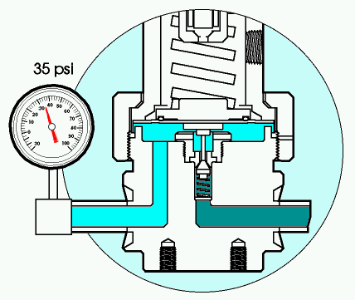
Tied Diaphragm Regulator
Regulator Types
Mechanical link between the diaphragm and poppet
Particle again shown coming through gas stream and lodging between seat and poppet
gas leaks across the seat causing an increase of outlet pressure
The link between poppet and diaphragm,diaphragm pulls poppet tighter

Slide 21
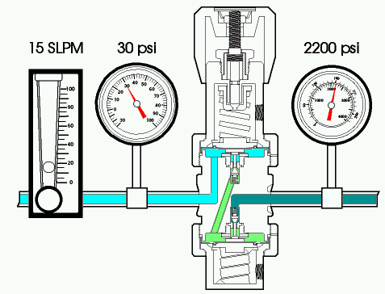

Two Stage Tied Diaphragm Regulator
Regulator Types
Two stage regulators are simply two regulators in series in a common body
Cylinder pressure decays, 1” stage outlet pressure rise is small and doesn’t cause change in 2” stage outlet pressure
Note: pressure and flow conditions

Slide 22
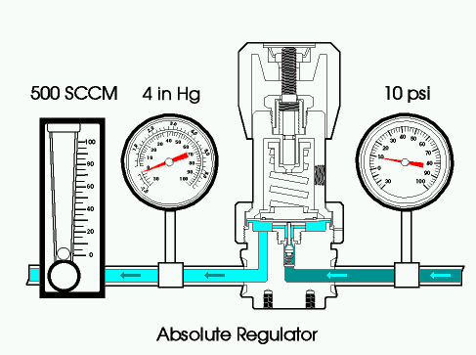
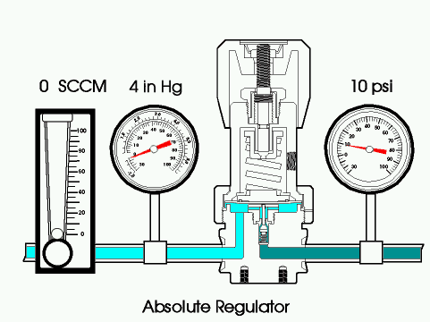
Absolute Pressure Regulators
Regulator Types
Designed to deliver outlet pressures below atmospheric pressure (vacuum)
Incorporate a bias spring pushing or pulling the diaphragm to allow vacuum to be controlled on the outlet side
Notes:
Instructor Notes:
Cover structural differences – reverse bias spring. Location and function.

Slide 23
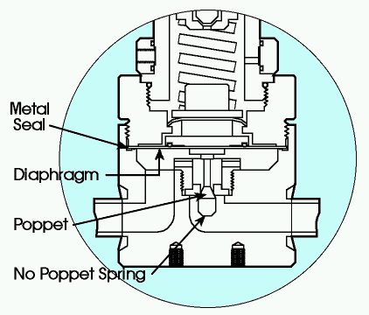
Springless Regulator
Regulator Types
Springless means no poppet spring
Mechanism to attach poppet expensive
No difference in performance, meaning particle generation, dry down or regulation
Increased cost with no benefit
Diaphragm is still a wetted spring

Slide 24
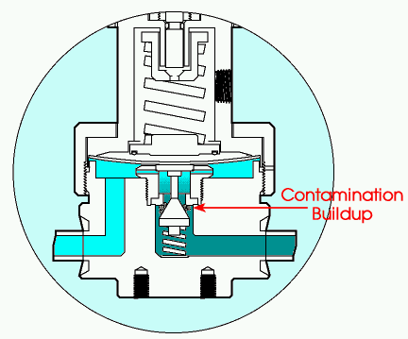
Across the Seat Leak
Regulator abnormal
Leakage is caused by particles lodging between the seat and the poppet
These particle prevent the poppet from fully closing and allow gas to leak across the seat
Generally caused by contaminates from the cylinder or poor purge technique

Slide 25
Across the seat leak causes
Regulator abnormal
Contamination from the gas source, either particles or moisture
Contamination from the piping system, such as tubing facing chips
Contamination created by poor purging technique or allowing moisture into piping
Wrong seat material for gas
Exceeding the temperature rating of the device

Slide 26
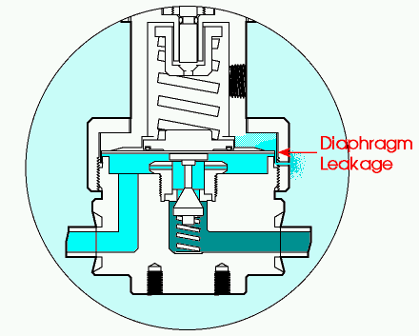
Outboard Leak
Regulator abnormal
Outboard leakage is leakage from inside the regulator to the atmosphere
Though very rare, most common leak path is at body to diaphragm seal

Slide 27
Outboard leak (continued)
Regulator abnormal
A leak detected at the bonnet nut leak check port is a diaphragm to body seal leak
A leak detected through the bonnet vent port is a leak through the central region of the diaphragm

Slide 28
Outboard leak main causes
Regulator abnormal
Excessive cycle purging can cause a diaphragm fracture when diaphragm cycle life, vacuum to positive pressure cycles, is exceeded
Over pressurization of the diaphragm can cause diaphragm to body leak or fracture
Corrosion on diaphragm, either internal or external, can cause diaphragm leak

Slide 29
Operator induced failure
Regulator abnormal
Wrong regulator selection for application
Materials of construction not compatible
Sized improperly for flow or pressure
Pressure lock up with tied diaphragm regulator
Closed regulator with trapped pressure under the diaphragm pulling poppet into seat

Slide 30
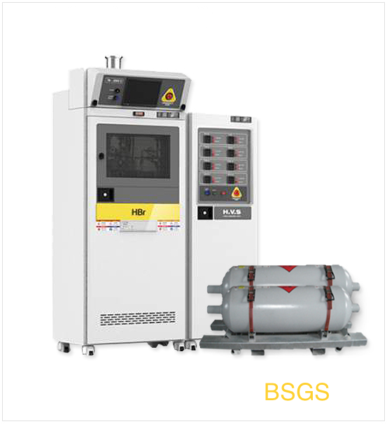
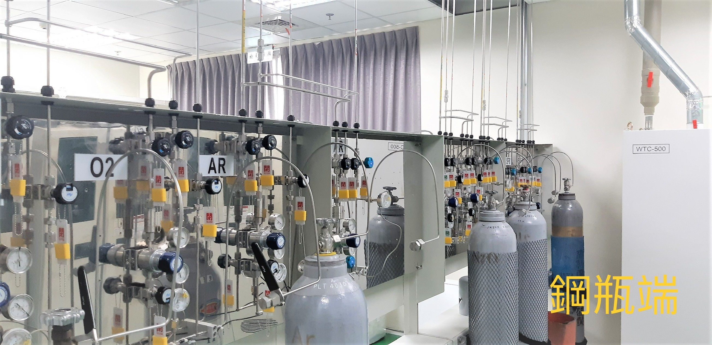
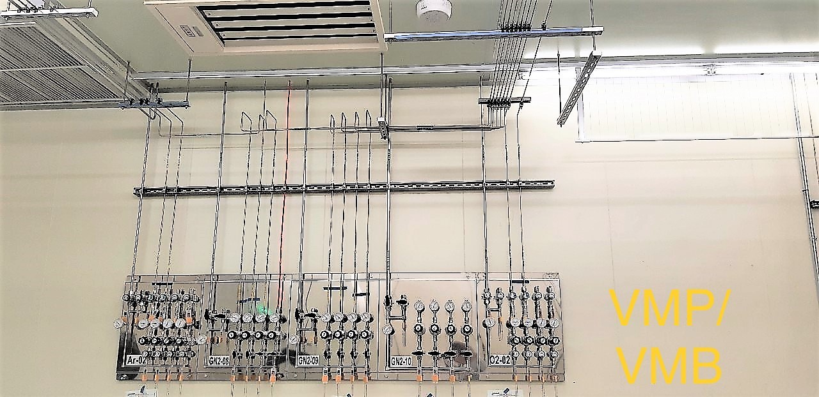
Regulator Selection
Review of type Information
Free-Poppet
- No Mechanical Linkage
between poppet and Dia.
Tied-Diaphragm
- Mechanical Linkage
between poppet and Dia.
Tow-Stage
- 2 Single Stage combine
Absolute Regulator
- Can be regulated by pressure
100 mg absolute~10 Psi

Slide 31
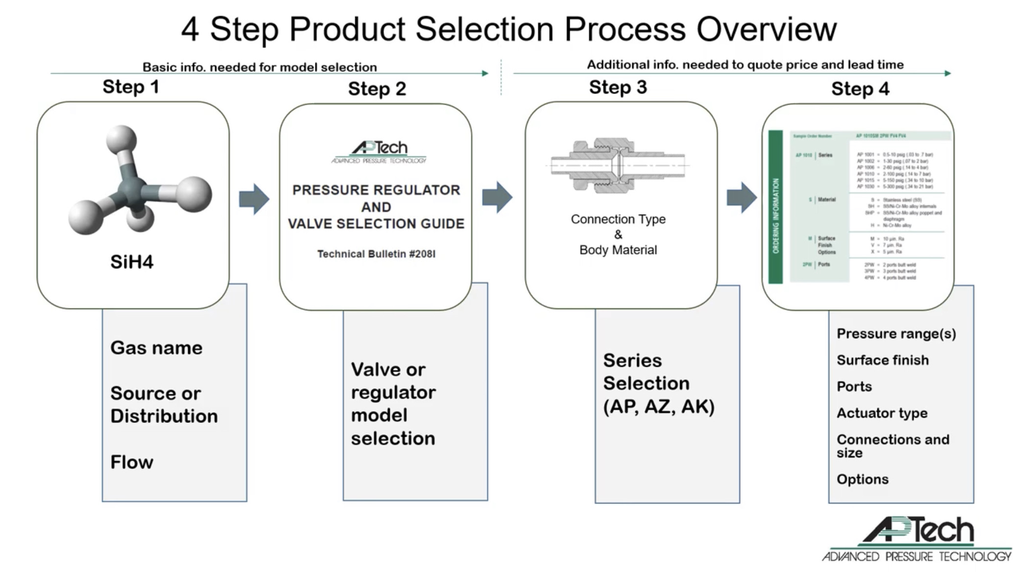
Regulator Selection

Slide 32
Regulator Selection
Example: SiH4 , Source Regulator , 120 lpm , Inlet:1400Psi Out:100 Psi
Type | Free poppet
 | Tied-Diaphragm
Gas | Corrosive | Double Melt Hastelloy
 | Non-Corrosive | SS316L
Flow | 0~120SLPM | Standard
 | 120~600SLPM | Intermediate
 | 800~1500 SLPM | High Flow
Other | 2Port , 3Port , 4Port

Slide 33
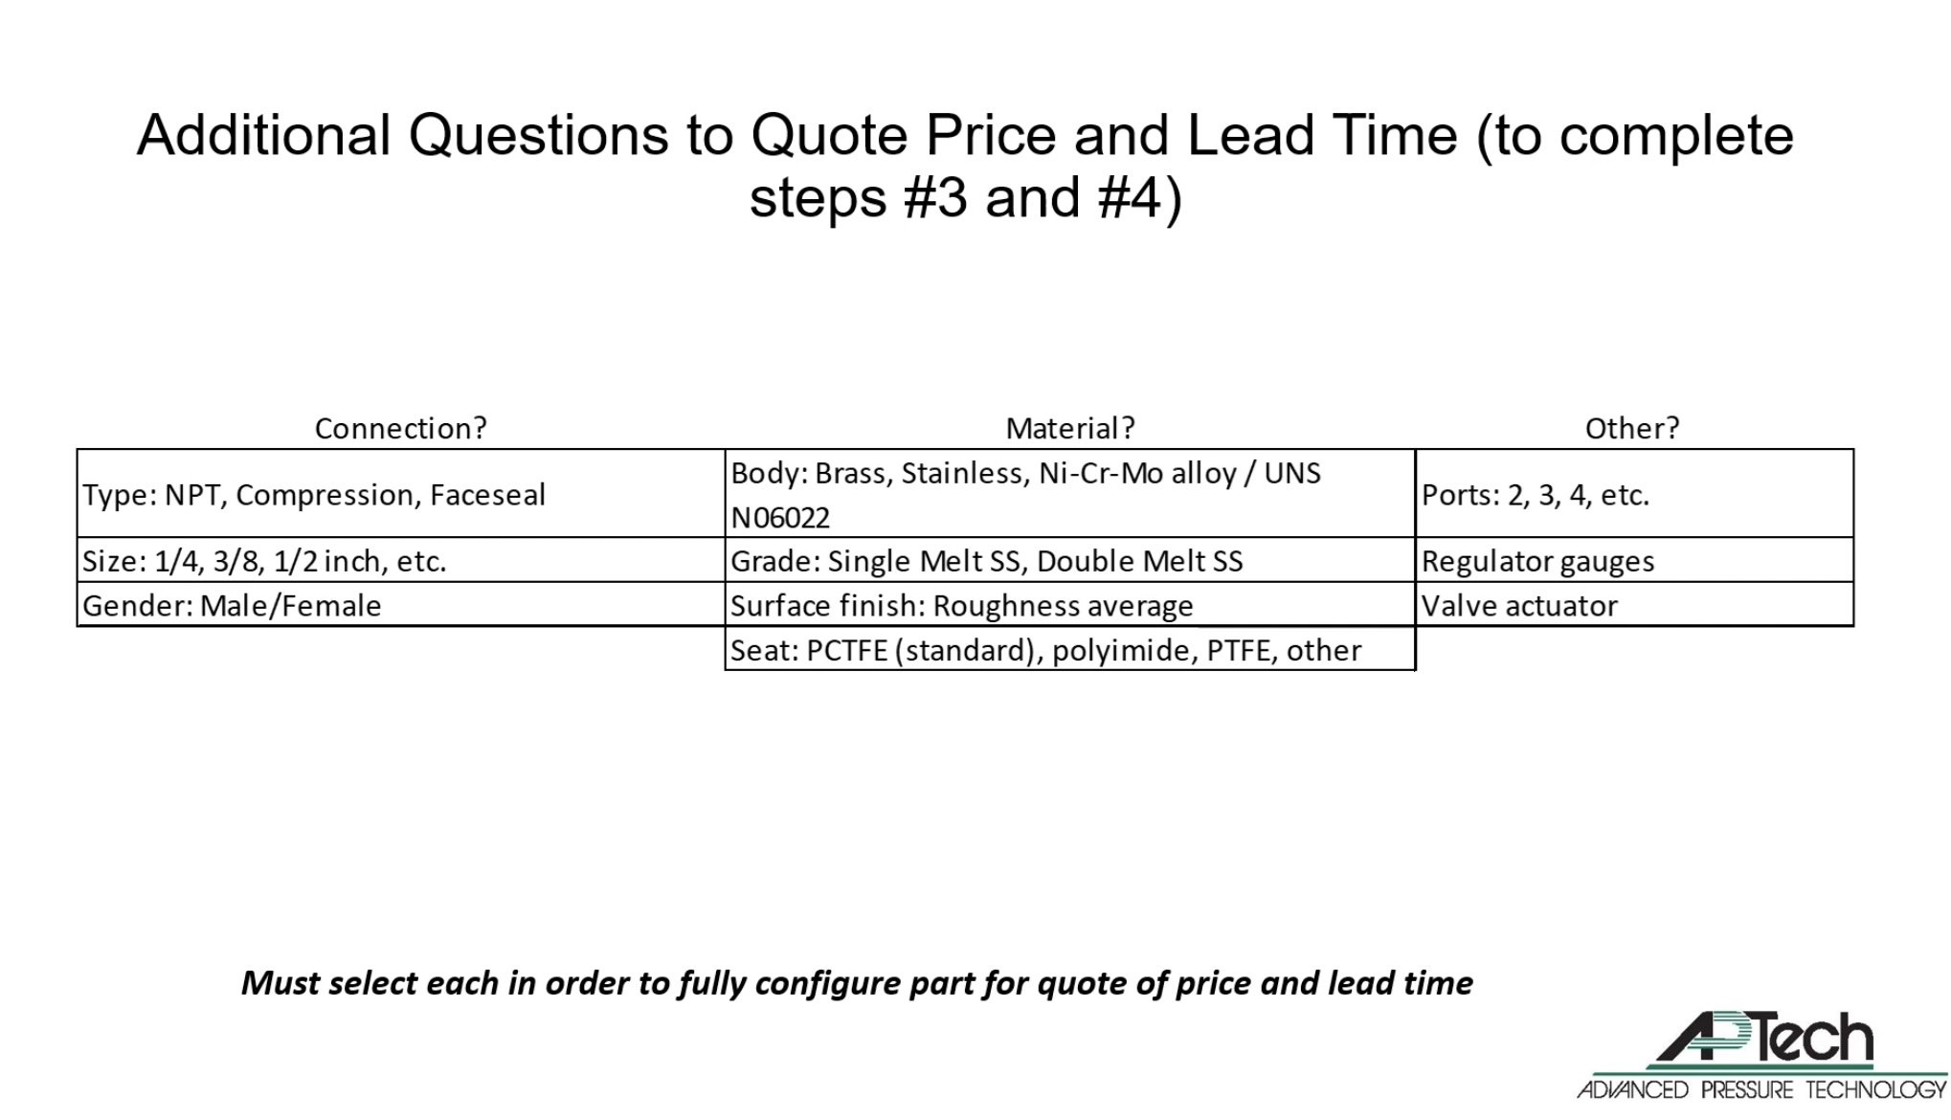
Regulator Selection

Slide 34
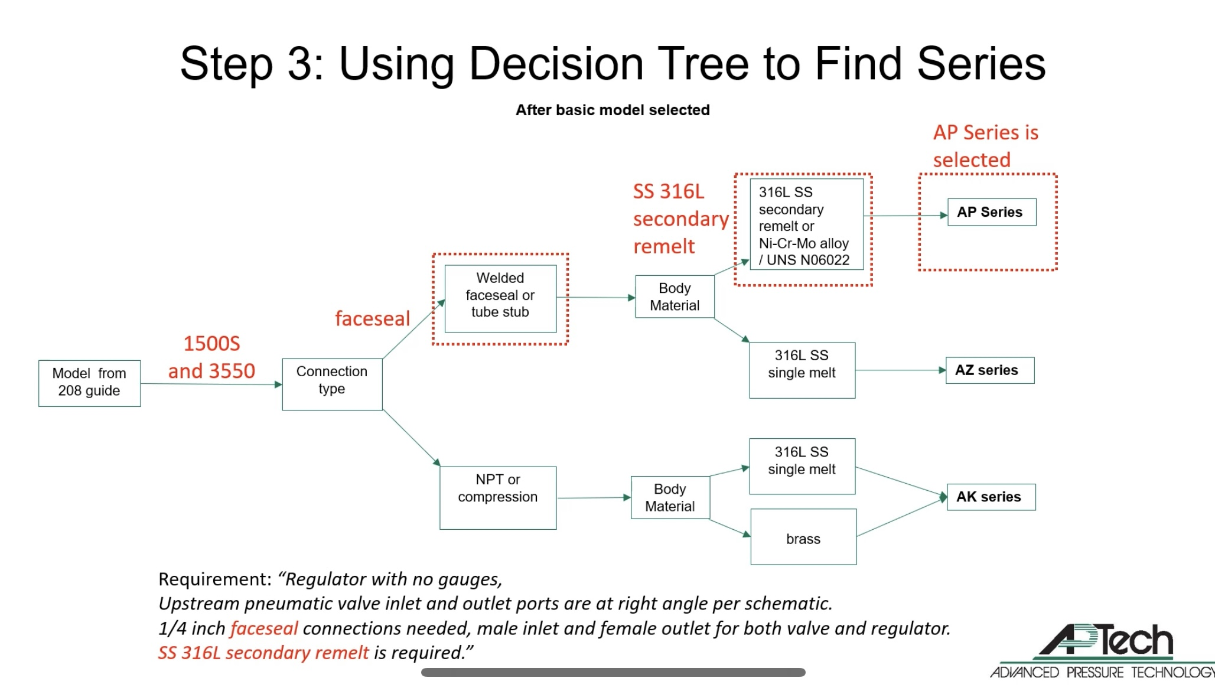
Regulator Selection

Slide 35
Q A Time
Questions and answers

